Slide 1
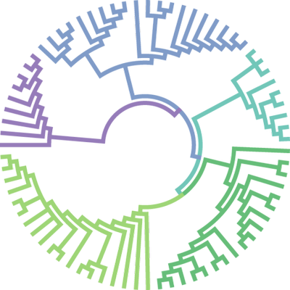
Lab 2 Building Trees: Changes through time

Slide 2
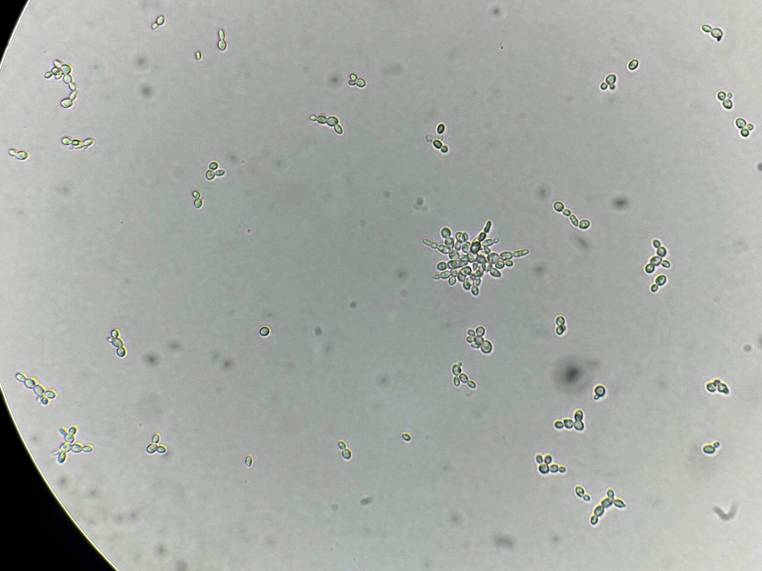

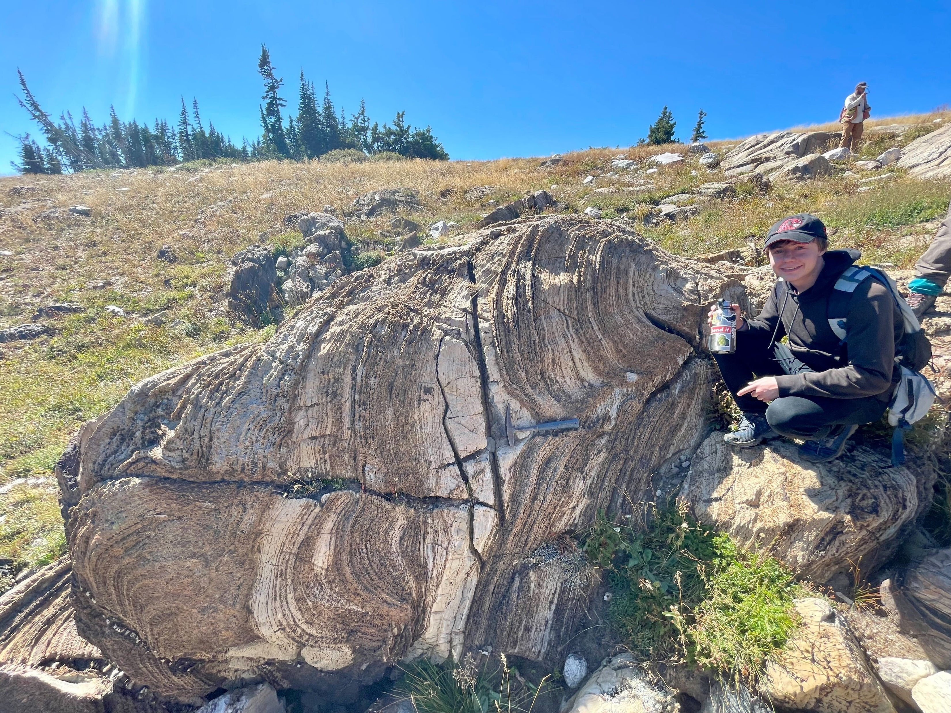
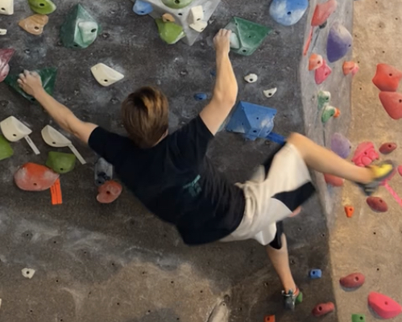
Lead Ta : Brysyn Goodson
Office Hour: Wednesdays 12-1
Email: goodsonb@oregonstate.edu
Hobbies: bodyboarding, climbing, tardigrade hunting, fossil hunting, and stromatolite enthusiast

Slide 3
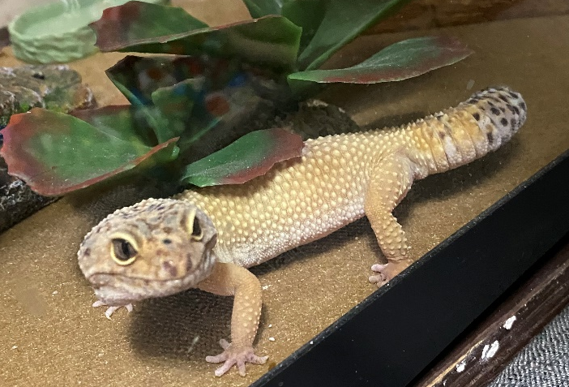
Housekeeping
DUE TODAY
Lab 2 pre-lab
DUE NEXT WEEK
Lab 3 pre-lab
Building Trees Take Home
GENERAL
Skills demonstrations start next week

Slide 4

Recap: natural selection
3 requirements for evolution by natural selection
Variation
Heritability
Selection

Slide 5
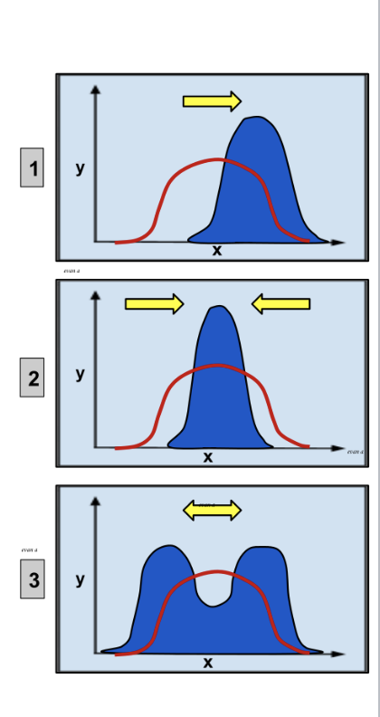
Recap: Types of Selection
Directional selection: selection toward one extreme phenotype
Stabilizing selection: selection for intermediate phenotype
Disruptive selection: selection for both extreme phenotypes

Slide 6
Lab 2 Learning Outcomes
Explain that organisms are related through evolutionary history, and organisms that are more closely related share unique traits that organisms less closely related do not have.
Classify organisms using morphology.
Describe how evolution (descent from a common ancestor with modification) explains the differences and similarities in morphology among organisms.
Interpret phylogenetic trees demonstrating relationships between organisms, and discuss those relationships.
Construct simple phylogenetic trees based on shared derived characteristics of organisms, and their accumulated knowledge of the relationships between organisms.
Describe why a phylogenetic tree is a hypothesis.
Notes:
Do people think we achieved these?

Slide 7
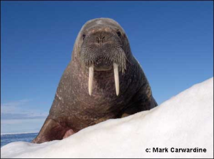
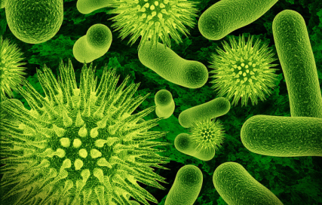
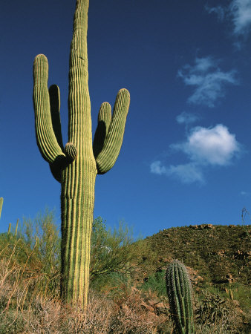
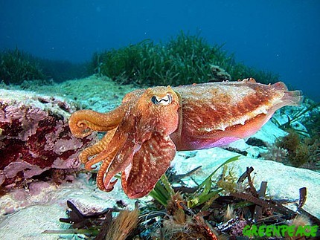
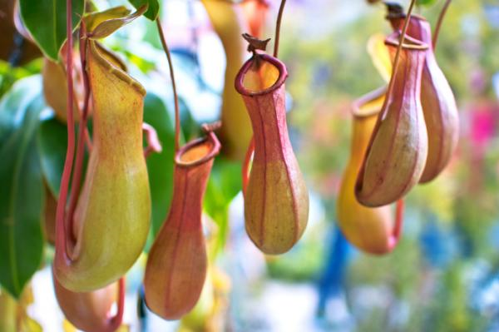
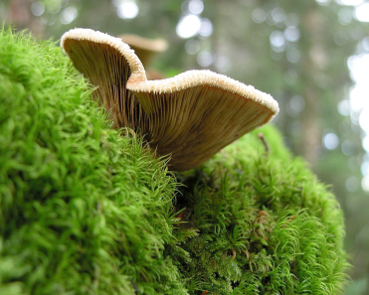
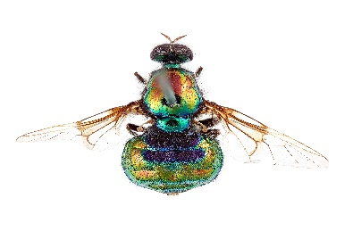
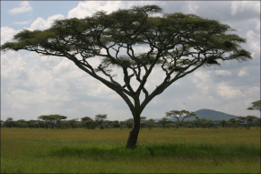
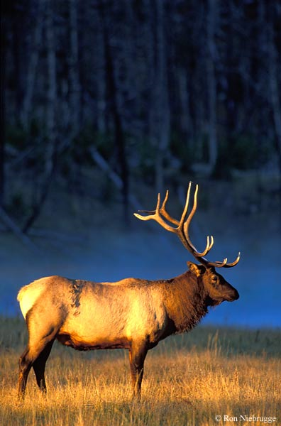
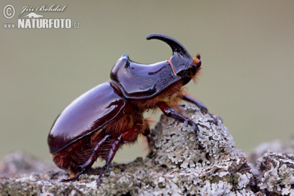
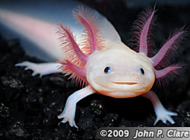

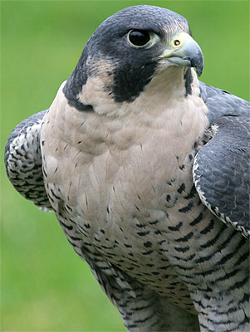
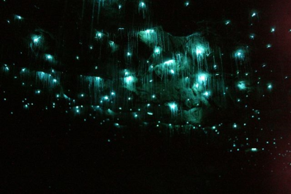
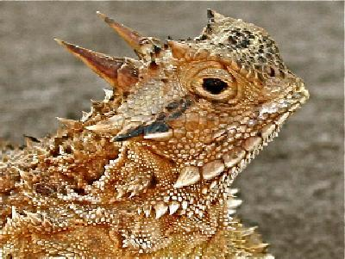
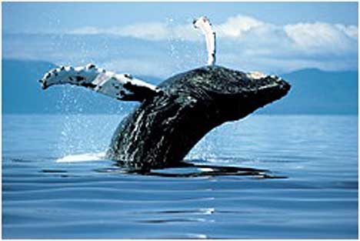
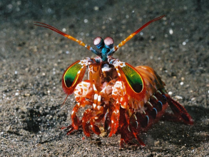
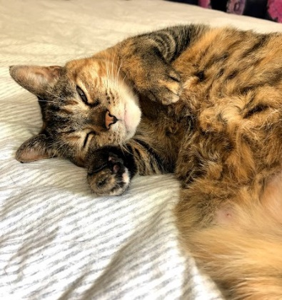
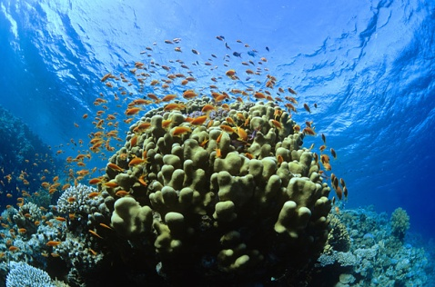
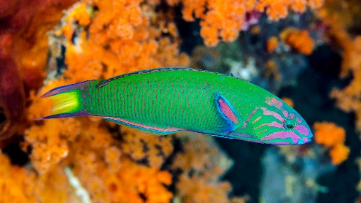
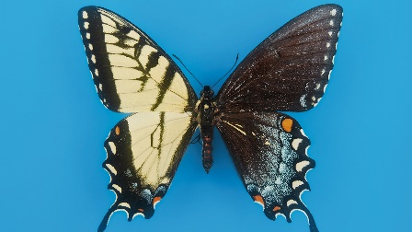

Slide 8
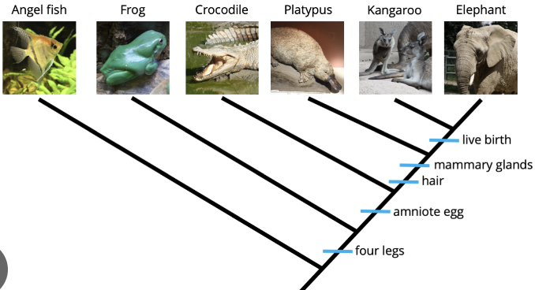
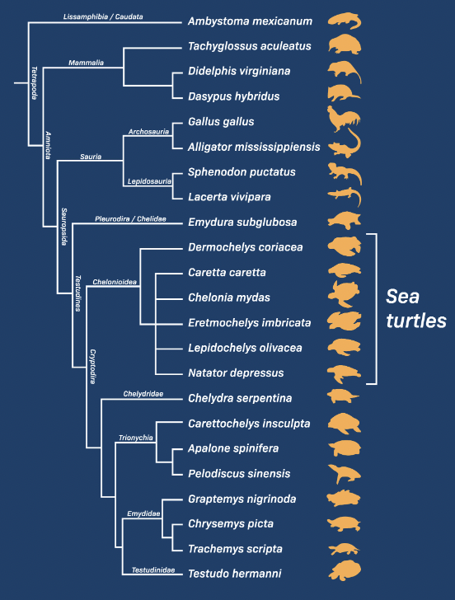
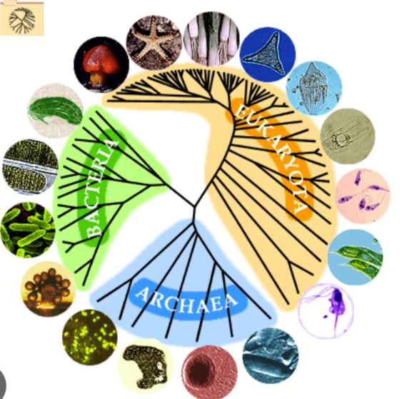
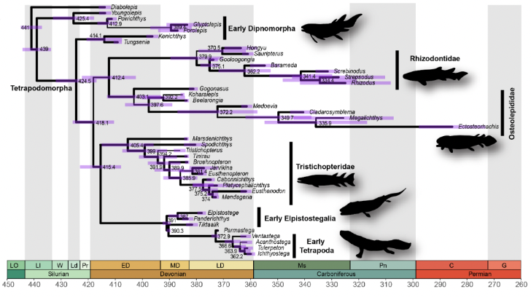
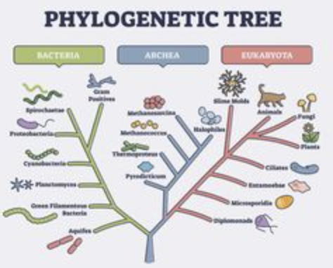
How do we organize the diversity of life?
In other words, how do we visualize evolution?
Through Phylogenetic Trees

Slide 9
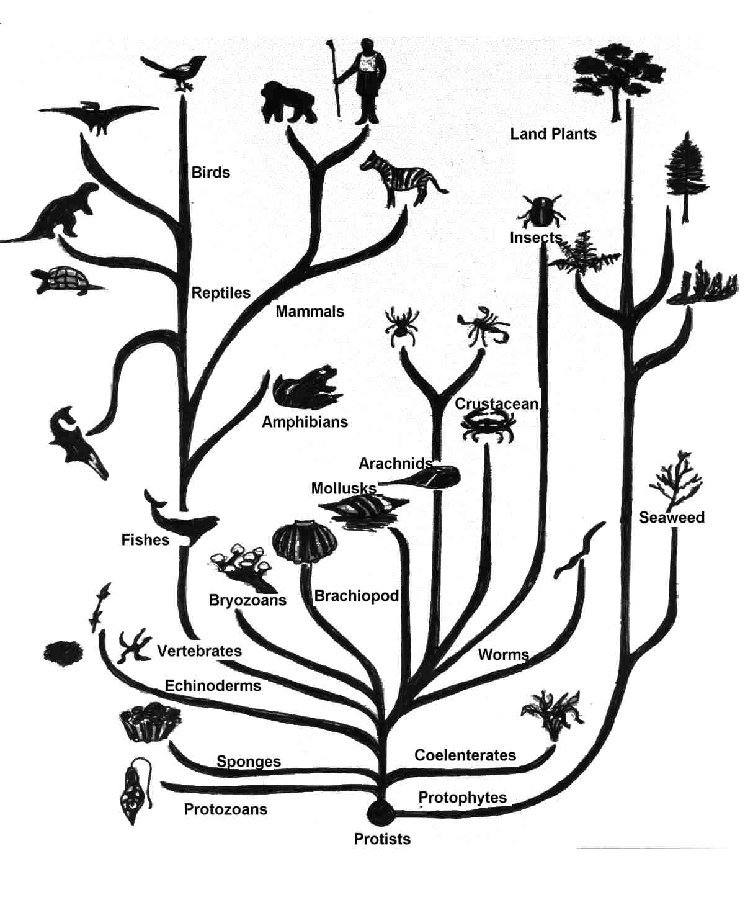
Classic View: Tree of life
Phylogenetic Tree:
Depiction of hypothesized relationships between a set of species.

Slide 10
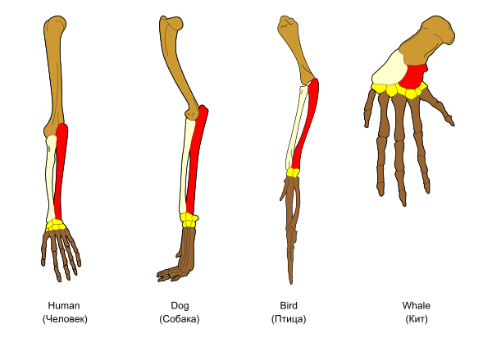
Organizing Principle: Evolution
Evolution = “descent (from a common ancestor) with modification”
The theory that all species are descended from a common ancestor and have changed with time.
Organisms share traits / characteristics
because they’re related.
Organisms are different because
they have adaptations / modifications
Morphology: the form (shape, color, etc.)
and structure of organisms
Can use relationships between organisms (evolution) to organize the diversity of life.

Slide 11
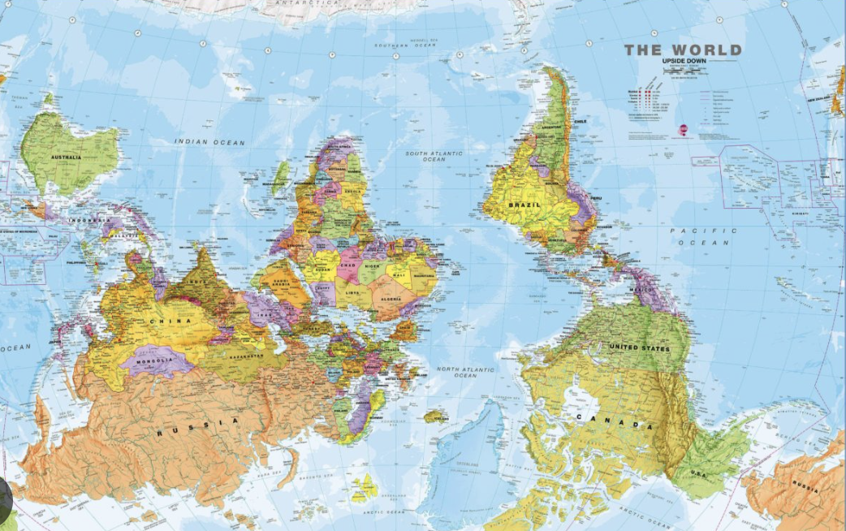
Classic View: Tree of life
Tree Tip #1:
There is no hierarchy in evolution
There is no perfect end state

Slide 12
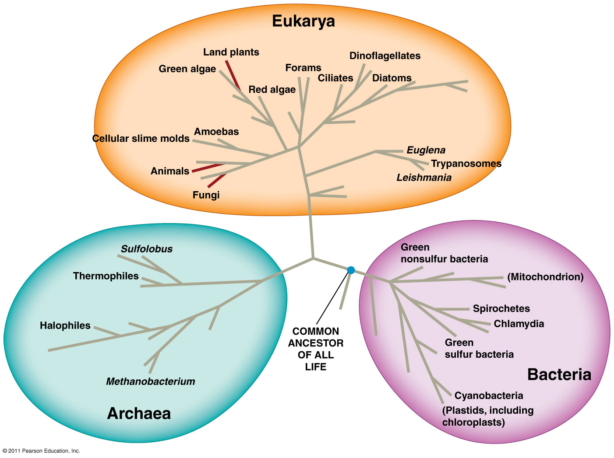
Another View: “bush” of life
Tree Tip #2:
Change your point of view often

Slide 13
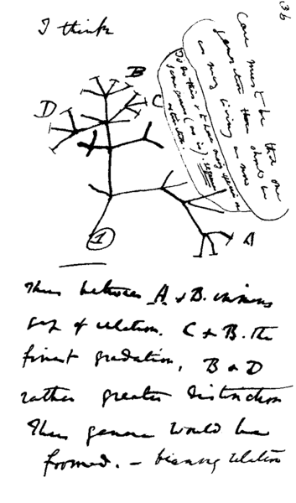
First tree: Darwin
Charles Darwin's 1837 sketch, his first diagram of an evolutionary tree from his First Notebook on Transmutation of Species (1837) on view at the Museum of Natural History in Manhattan.
Notes:
Interpretation of handwriting: "I think case must be that one generation should have as many living as now. To do this and to have as many species in same genus (as is) requires extinction . Thus between A + B the immense gap of relation. C + B the finest gradation. B+D rather greater distinction. Thus genera would be formed. Bearing relation" (next page begins) "to ancient types with several extinct forms".

Slide 14
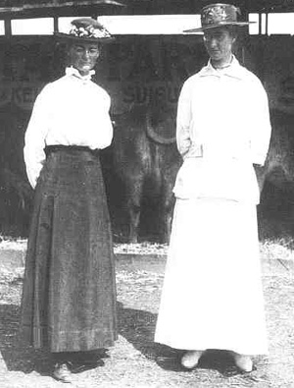
The Wide World of Science!
Annie Alexander and Louise Kellogg
Early 20th Century
Alexander and Kellogg founded the Museums of Zoology and Paleontology at Berkeley
Expeditions in Oregon lead to the discovery of many fossils
Collections are integral to understanding the origins and relationships of creatures on earth
Annie Louise
Alexander Kellogg
Notes:
Notes from slide:
Alexander and Kellogg founded the Museums of Zoology and Paleontology at Berkeley
Expeditions in Oregon lead to the discovery of many fossils
Collections are integral to understanding the origins and relationships of creatures on earth
Additional notes:
Their expeditions in Oregon and Northern California uncovered thousands of paleontological specimens, which are still used to date phylogenetic trees today.
The collections at Berkeley launched a renewed interest in the origin of species in the Western United States, and both facilities are now regarded as the best of their type in the United States, with large, admired and, in some cases, unique, collections of specimens
Annie was involved in an expedition during which some of the finest specimens of ichthyosaur (giant marine mammals from over 100 million years ago!) were discovered
At the time, Alexander and Kellogg’s relationship was regarded as a “Boston Marriage” – a devoted relationship between two women
In an era when ‘women’ and ‘scientist’ were two unrelated terms by societal perception, Alexander and Kellogg contributed to the scientific legacy of the Western United States in a profound way. Despite sexism and homophobia, they accomplished a tremendous feat that still benefits the West.
In their free time, Alexander and Kellogg tended a ranch together
Sources
https://projectbiodiversify.org/2019/10/26/annie-montague-alexander/.
Stein, B.R., 1996. Women in mammalogy: the early years. Journal of mammalogy, 77(3), pp.629-641.
https://www.nps.gov/pefo/learn/historyculture/scientistsresearchers.htm
https://bancroft.berkeley.edu/collections/gaybears/alexkel/ (to learn more about Alexander and Kellogg’s very sweet romance)

Slide 15
The Wide World of Science!
Why are fossils important in studying evolution?
Annie Alexander and Louise Kellogg
Early 20th Century
Alexander and Kellogg founded the Museums of Zoology and Paleontology at Berkeley
Expeditions in Oregon lead to the discovery of many fossils
Collections are integral to understanding the origins and relationships of creatures on earth
Annie Louise
Alexander Kellogg
Notes:
Notes from slide:
Alexander and Kellogg founded the Museums of Zoology and Paleontology at Berkeley
Expeditions in Oregon lead to the discovery of many fossils
Collections are integral to understanding the origins and relationships of creatures on earth
Additional notes:
Their expeditions in Oregon and Northern California uncovered thousands of paleontological specimens, which are still used to date phylogenetic trees today.
The collections at Berkeley launched a renewed interest in the origin of species in the Western United States, and both facilities are now regarded as the best of their type in the United States, with large, admired and, in some cases, unique, collections of specimens
Annie was involved in an expedition during which some of the finest specimens of ichthyosaur (giant marine mammals from over 100 million years ago!) were discovered
At the time, Alexander and Kellogg’s relationship was regarded as a “Boston Marriage” – a devoted relationship between two women
In an era when ‘women’ and ‘scientist’ were two unrelated terms by societal perception, Alexander and Kellogg contributed to the scientific legacy of the Western United States in a profound way. Despite sexism and homophobia, they accomplished a tremendous feat that still benefits the West.
In their free time, Alexander and Kellogg tended a ranch together
Sources
https://projectbiodiversify.org/2019/10/26/annie-montague-alexander/.
Stein, B.R., 1996. Women in mammalogy: the early years. Journal of mammalogy, 77(3), pp.629-641.
https://www.nps.gov/pefo/learn/historyculture/scientistsresearchers.htm
https://bancroft.berkeley.edu/collections/gaybears/alexkel/ (to learn more about Alexander and Kellogg’s very sweet romance)

Slide 16
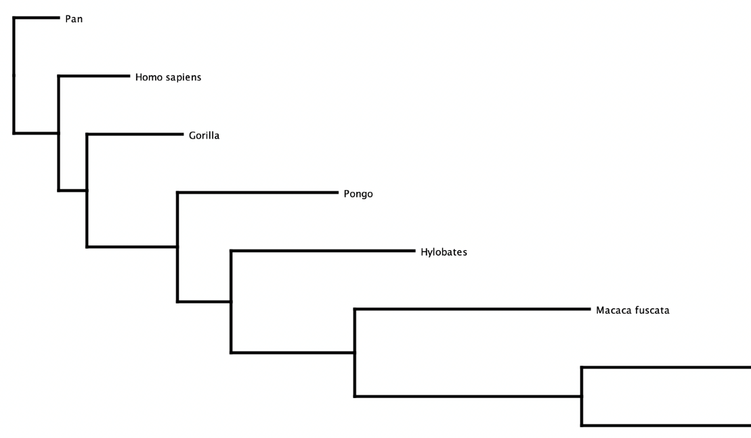
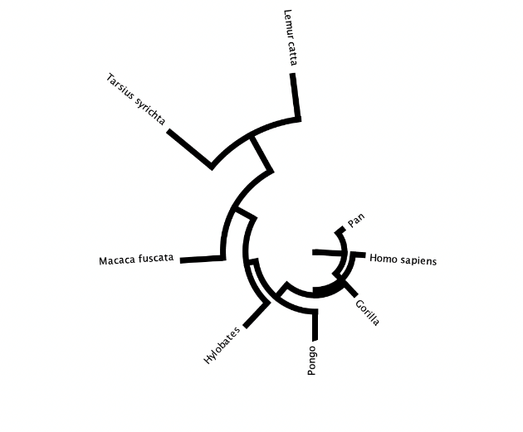
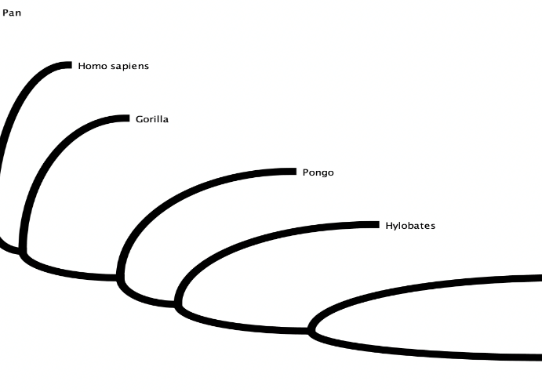
Tree Tip #3: Trees are visualized in many ways

Slide 17
Terminology
Phylogenetic Tree: Depiction of hypothesized relationships between a set of species.
Sister Species
Extant (living) species
Common
Ancestor
4 Limbs
Node
Shared Derived Character
Branch
Tip
Notes:
Ancestral Trait: trait shared by two or more taxa
Shared derived character: trait that two lineages have in common
Sister species: closest relatives

Slide 18
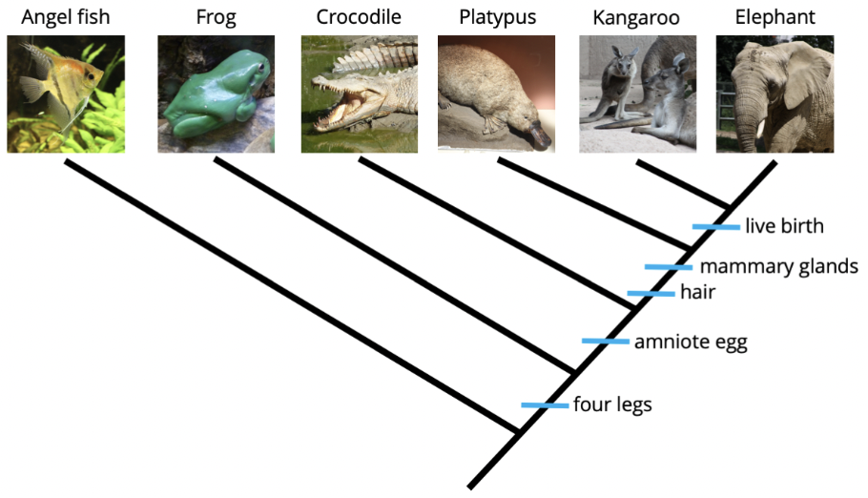
Clade: A common ancestor and all of it’s descendants

Slide 23
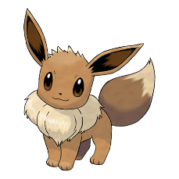
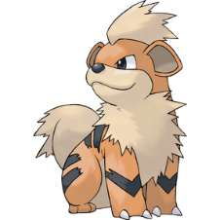

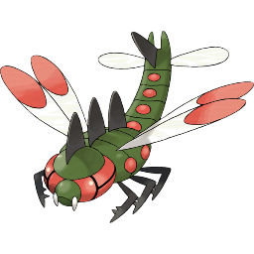

Clade (branch):
A common ancestor and all its descendents.
Fur
Four legs
Shell
Eyes
Wings
Six legs

Slide 24
How many clades do you see in this tree?
4!

Slide 25
How do we build a phylogenetic tree?
Fur
Four legs
Shell
Eyes
Wings
Six legs

Slide 26




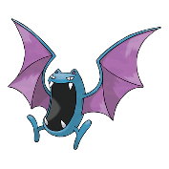
How to build a phylogenetic tree (of Pokémon)
 | Four legs | Fur | Shell | Wings

Slide 27
How to build a phylogenetic tree (of Pokémon)
 | Four legs | Fur | Shell | Wings
 | 1
 | 1
 | 1
 | 0
 | 0

Slide 28
How to build a phylogenetic tree (of Pokémon)
 | Four legs | Fur | Shell | Wings
 | 1 | 1
 | 1 | 1
 | 1 | 0
 | 0 | 0
 | 0 | 0

Slide 29
How to build a phylogenetic tree (of Pokémon)
 | Four legs | Fur | Shell | Wings
 | 1 | 1 | 0
 | 1 | 1 | 0
 | 1 | 0 | 1
 | 0 | 0 | 0
 | 0 | 0 | 0

Slide 30
How to build a phylogenetic tree (of Pokémon)
 | Four legs | Fur | Shell | Wings
 | 1 | 1 | 0 | 0
 | 1 | 1 | 0 | 0
 | 1 | 0 | 1 | 0
 | 0 | 0 | 0 | 1
 | 0 | 0 | 0 | 1

Slide 31
How to build a phylogenetic tree (of Pokémon)
 | Four legs | Fur | Shell | Wings
 | 1 | 1 | 0 | 0
 | 1 | 1 | 0 | 0
 | 1 | 0 | 1 | 0
 | 0 | 0 | 0 | 1
 | 0 | 0 | 0 | 1
This is called a Character Matrix

Slide 32
How to build a phylogenetic tree (of Pokémon)
 | Four legs | Fur | Shell | Wings
 | 1 | 1 | 0 | 0
 | 1 | 1 | 0 | 0
 | 1 | 0 | 1 | 0
 | 0 | 0 | 0 | 1
 | 0 | 0 | 0 | 1
This is called a Character Matrix
Trait data needs to be present/absent. If given data that is not present/absent – change the trait description

Slide 33
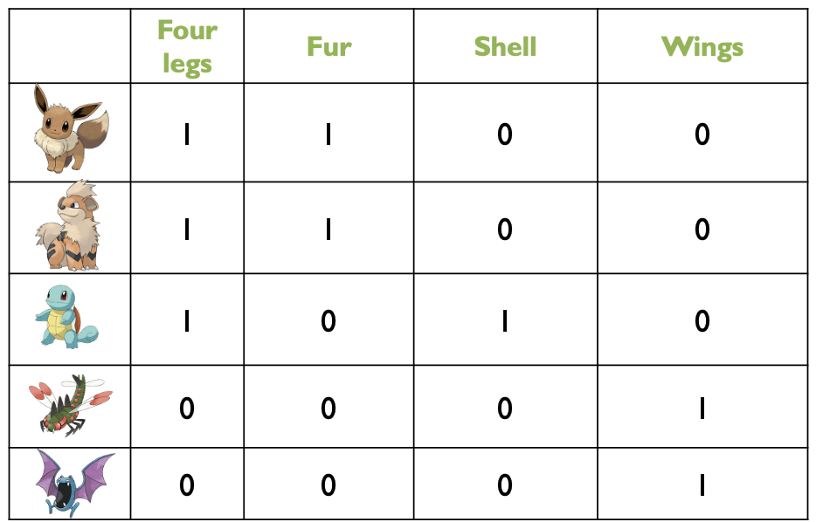
How to build a phylogenetic tree (of Pokémon)
Start with most prevalent traits.

Slide 34
How to build a phylogenetic tree (of Pokémon)
Eyes are shared by all – and must be the ancestral trait.
Eyes

Slide 35
How to build a phylogenetic tree (of Pokémon)
Check if any Pokémon (rows) have only the ancestral trait (a 0 everywhere else)
Eyes

Slide 36

How to build a phylogenetic tree (of Pokémon)
When placing an organism, check if others differ by just one trait
Eyes
Wings

Slide 37

How to build a phylogenetic tree (of Pokémon)
When placing an organism, check if others differ by just one trait
Eyes
Wings

Slide 38





How to build a phylogenetic tree (of Pokémon)
 | Four legs | Fur | Shell | Wings
 | 1 | 1 | 0 | 0
 | 1 | 1 | 0 | 0
 | 1 | 0 | 1 | 0
 | 0 | 0 | 0 | 1
 | 0 | 0 | 0 | 1
Repeat with ‘reduced’ matrix
Eyes
Wings

Slide 39
How to build a phylogenetic tree (of Pokémon)
 | Four legs | Fur | Shell | Wings
 | 1 | 1 | 0 | 0
 | 1 | 1 | 0 | 0
 | 1 | 0 | 1 | 0
 | 0 | 0 | 0 | 1
 | 0 | 0 | 0 | 1
Most prevalent trait
Eyes
Wings

Slide 40
How to build a phylogenetic tree (of Pokémon)
 | Four legs | Fur | Shell | Wings
 | 1 | 1 | 0 | 0
 | 1 | 1 | 0 | 0
 | 1 | 0 | 1 | 0
 | 0 | 0 | 0 | 1
 | 0 | 0 | 0 | 1
Add new branch
Four legs
Eyes
Wings

Slide 41
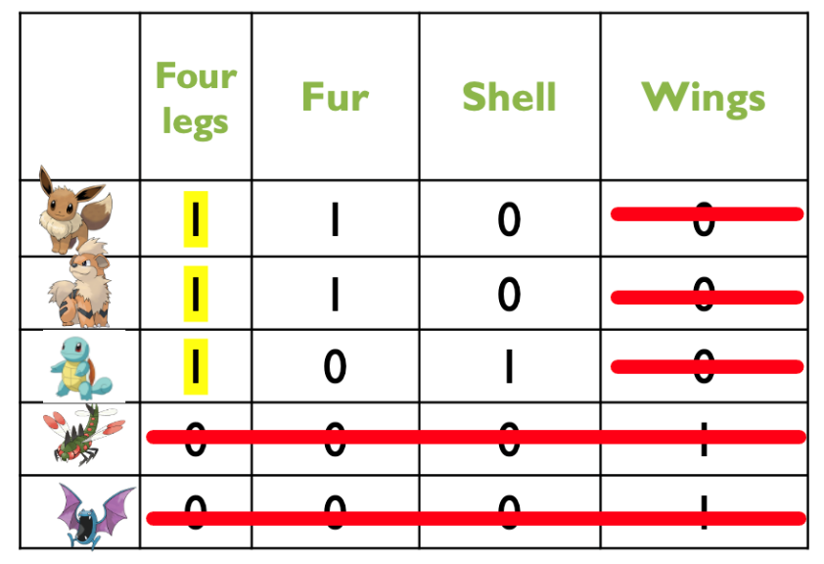
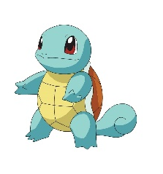
How to build a phylogenetic tree (of Pokémon)
Check if Pokémon (row) has only that trait
Four legs
Eyes
Shell
Wings

Slide 42
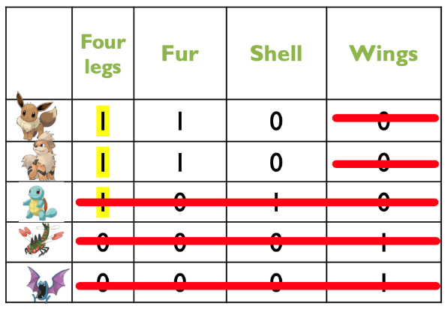

How to build a phylogenetic tree (of Pokémon)
Check if Pokémon (row) has only that trait
Fur
Four legs
Eyes
Shell
Wings

Slide 43


How to build a phylogenetic tree (of Pokémon)
Check if Pokémon (row) has only that trait
Fur
Four legs
Eyes
Shell
Wings

Slide 44
How to build a phylogenetic tree (of Pokémon)
Fur
Four legs
Eyes
Shell
Wings

Slide 45
Which is most closely related to Eevee?
Squirtle
Yanmega
Growlithe
Eevee
Fur
Four legs
Growlithe
Eyes
Squirtle
Shell
Yanmega
Wings
Golbat

Slide 46
Which is most closely related to Eevee?
Squirtle
Yanmega
Growlithe
Eevee
Fur
Four legs
Growlithe
Eyes
Squirtle
Shell
Yanmega
Wings
Golbat

Slide 47
Which is most closely related to Golbat?
Squirtle
Growlithe
Eevee
Eevee
Fur
Four legs
Growlithe
Eyes
Squirtle
Shell
Yanmega
Wings
Golbat

Slide 48
Which is most closely related to Golbat?
Squirtle
Growlithe
Eevee
Eevee
Fur
Four legs
Growlithe
Eyes
Squirtle
Shell
Yanmega
Wings
Golbat

Slide 49

Principle of Parsimony
The simplest explanation is most likely the best explanation.
The “true” tree is most likely the one the requires the fewest “steps.”
Assumptions: Development of a particular trait is a rare event

Slide 50
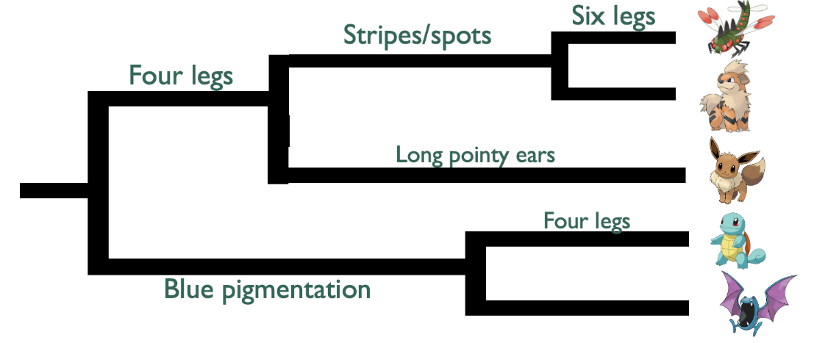

Which tree is more parsimonious?

Slide 51
Fur
Four legs
With your group: Make a phylogenetic tree of a nonliving system. Be creative! Examples: food, music genres, sports, etc.
Must have at least 5 extant species.
Eyes
Shell
Wings

Slide 52
Lab 2 Building Trees: Changes through time

Slide 53







Part 1: building a tree
Adapt!
Adapt!
Eats organisms
Energy storage
Speciate!
No adaptation.
Speciate!
No adaptation.
Adapt!
No Speciation.
Uses sulfur
Generation 0
Generation 1,000
Generation 2,000
Notes:
Complete part 1 Start with a single cell → the first cell speciates → pull an adapt/no adaptation card for each cell → repeat for 5 generations

Slide 54



How a Phylogeny in the game will look:
Eat
Organisms
Enclosed
Her. Mat.
Storage
Uses
Sulfur
Communication

Slide 55
How a Phylogeny is Typically Represented:
Eat
Organisms
Enclosed
Her. Mat.
Storage
Hereditary Material
Uses
Sulfur
Communic.

Slide 56






















Tree Worksheet
Generation 0
1,000
2,000
3,000
4,000
5,000
X
Time

Slide 57
Part II: assembling a phylogeny
Look at a previous groups extant species and develop a tree!

Slide 58







Tree uncertainty using morphology can be problematic
Extinction of a lineage
Divergence: Increasing differences
in a character within a clade
Convergence:
acquisition of similar traits
in different clades
Secondary Loss:
Loss of a derived trait

Slide 59
Organizing Your Data…
How would you make a datasheet to help you identify relatedness using traits? Character Matrix!
Ancestral Traits = 0 = character state present in common ancestor of all species in tree
Derived = 1 = character state that has changed since common ancestor of all species in tree
Species | Character 1 | Character 2 | Character 3 | Character 4
A
B
C
D

Slide 60
Try it out!
Given the following character matrix. Which tree better reflects the relationship between Species A, B, and C?
Species | Character 1 | Character 2 | Character 3 | Character 4 | Character 5
A | 1 | 1 | 1 | 0 | 1
B | 0 | 0 | 0 | 0 | 1
C | 0 | 0 | 1 | 0 | 1
A
B
C
A
C
B
C
B
A
A.
B.
C.

Slide 61
Types of Traits:
Informative:
Traits that are specific to a clade or sister species
Inform you where a species belongs in the tree
Uninformative
Traits that all the species share
Do not give you information on where the species belongs

Slide 62
Steps for Building a Tree:
Identify ancestral and derived character states for each trait.
Identify which traits are informative and cross out those that are not.
Identify sister taxa by looking for shared derived features shared by only two species.
Continue to group clades by shared derived features.

Slide 63

Today’s roadmap and tips:
Part 1: building a tree
IMPORTANT! Keep record of the tree you build! You will need it for part 2.
Part 2: assembling a phylogeny
Leave extant species on table, remove the rest of the tree, and switch with another group.
Complete the character matrix for the new tree
Build a tree using that group’s extant species and compare your tree to their original one.
Part 3: clean
Organize everything on your table
MAKE SURE GAME PIECES END UP IN THE CORRECT BAGS AT THE CORRECT TABLES

Slide 64

Questions?

